Slide 1
Good practice proposal – Building one access point to dispersed data sources
Marcin Grudzień Pushing WMS services to their limits 8th February 2022

Slide 2

Description of the GP (1)
Datasets maintained at a local level independently by different municipalities often:
Are very similar: have the same content, data model, structure, portrayal etc.
Have different spatial extend limited by boundaries of municipalities
A good example is cadastral data in Poland that is maintained by 380 counties (powiaty)
Counties maintain the cadastral datasets in the same national data model
Each county maintains a cadastral dataset limited spatially to its boundaries
Each county is obliged by law to publish network services providing dataset the county maintains
This results in 380 WMS services published by districts providing cadastral datasets

Slide 3

Description of the GP (2)
Let’s create a proxy, collective service that integrates local services
Originator and author of collective services is Professor Waldemar Izdebski

Slide 4

Benefits
One endpoint for a particular dataset (e.g. cadastre) for the entire country
It saves user’s time – the user doesn't have to search for endpoints of view services published by different counties
It hides the complexity of the SDI implementation – from the user perspective, integrated service provides access to one seamless dataset

Slide 5

Intendent outcome
Users should access dispersed datasets from a single endpoint
This can be, for example, done as:
a single national endpoint per dataset integrating services published by municipalities
a single European access point per INSPIRE theme integrating services provided by the Member States

Slide 6
How it works? (1)
Request forwarded to many local services
WMS client application
First local WMS service
1 – GetMap WMS Request
4 – Merging (flattening) of local services WMS GetMap responses
Second local WMS service
Collective, proxy WMS service
5 – GetMap WMS
response
2 – GetMap WMS
request
Spatial extends of counties
3 –GetMap WMS
response
Third local WMS service

Slide 7
How it works? (2)
Request forwarded to one local service
3 – GetMap WMS request
WMS client application
First local WMS service
4 –GetMap WMS response
1 – GetMap WMS Request
Second local WMS service
Collective, proxy WMS service
2 – 302 redirection
GetMap WMS
response containing
request URL
to the local service
Spatial extends of counties
Third local WMS service

Slide 8
Evidence of implementation (1)
There are the following integrating WMS services available:
KIEG – cadastral data (cadastral parcels and buildings) https://integracja.gugik.gov.pl/cgi-bin/KrajowaIntegracjaEwidencjiGruntow
KIUT – utility infrastructure data (electricity, water, telecommunication, sewers, gas and other networks) https://integracja.gugik.gov.pl/cgi-bin/KrajowaIntegracjaUzbrojeniaTerenu
KIBDOT – large scale topographic data (containing the location of fences, trees, curbs, etc. ) https://integracja.gugik.gov.pl/cgi-bin/KrajowaIntegracjaBazDanychObiektowTopograficznych
KIMP – local development plans https://mapy.geoportal.gov.pl/wss/ext/KrajowaIntegracjaMiejscowychPlanowZagospodarowaniaPrzestrzennego
KISKZP – local land use study https://mapy.geoportal.gov.pl/wss/ext/KrajowaIntegracjaStudiumKierunkowZagospodarowaniaPrzestrzennego

Slide 9
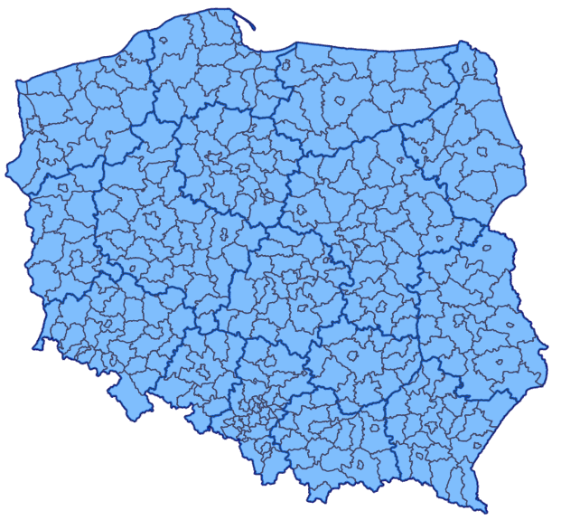
Evidence of implementation (2)
Number of integrated local services
KIEG – 380 counties
KIUT – 380 counties
KIBDOT – 126 counties
KIMP – 1564 communes
KISKZP – 1052 communes

Slide 10










Evidence of implementation (3)
INSPIRE themes covered
Administrative units
Cadastral parcels
Hydrography
Transport networks
Elevation
Land cover
Buildings
Land use
Soil
Utility and governmental services

Slide 11
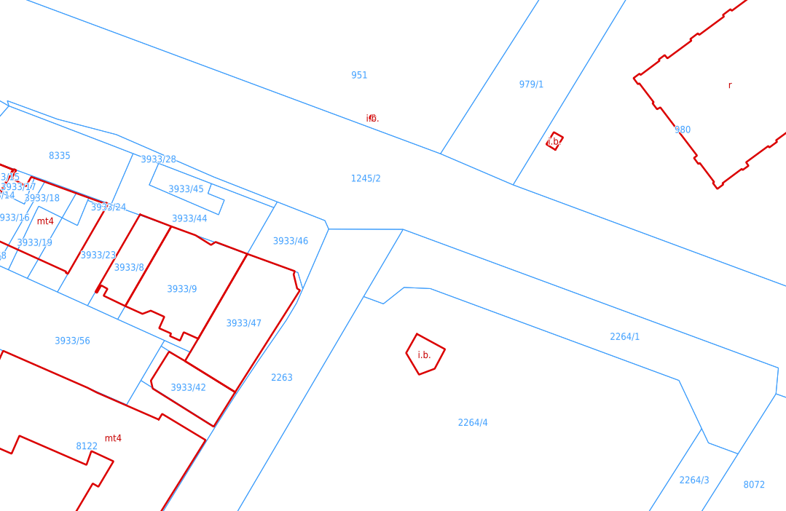
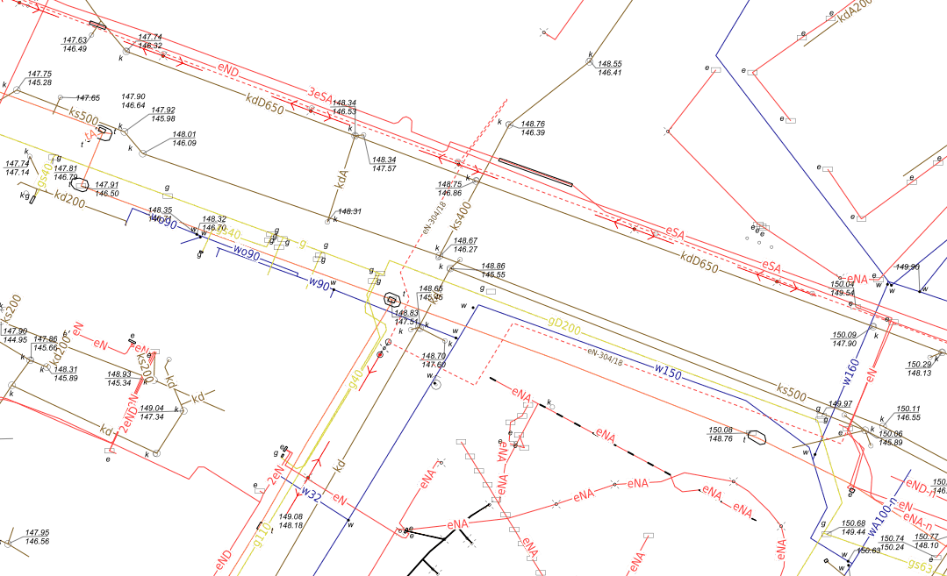
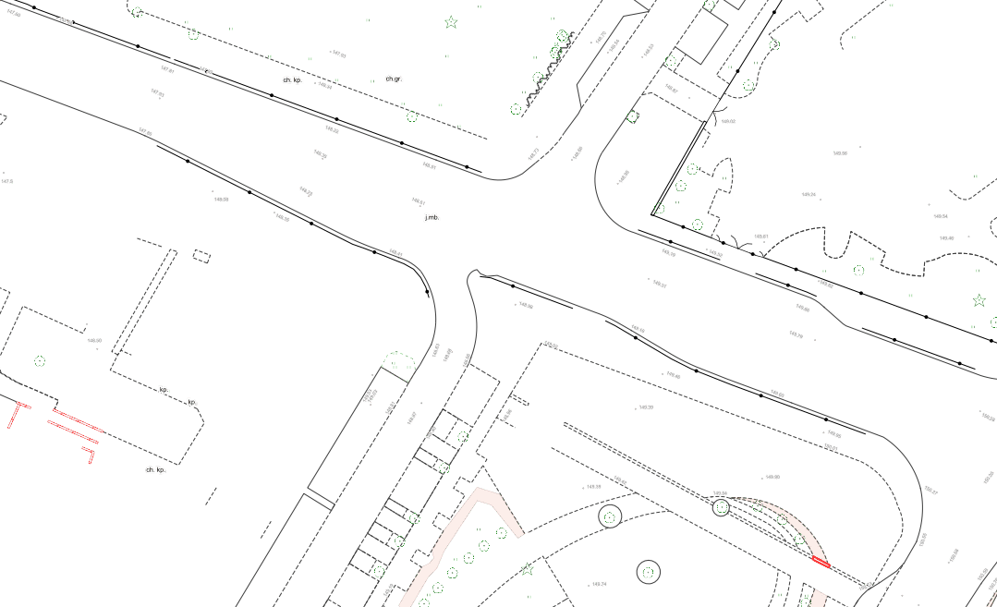
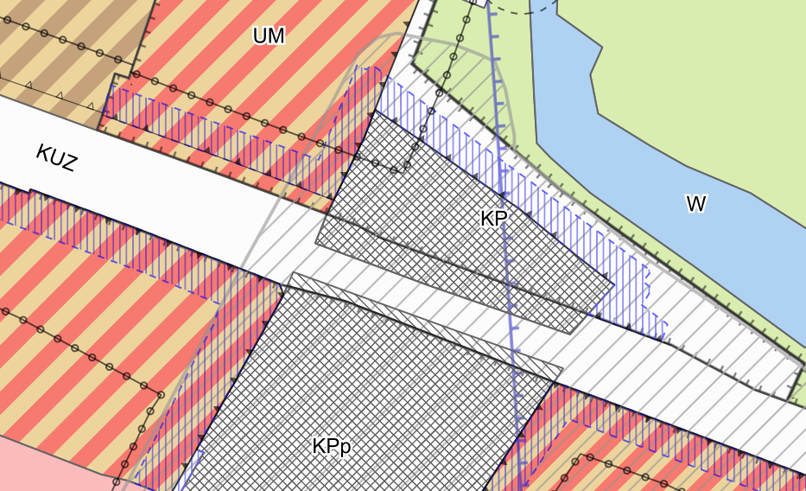
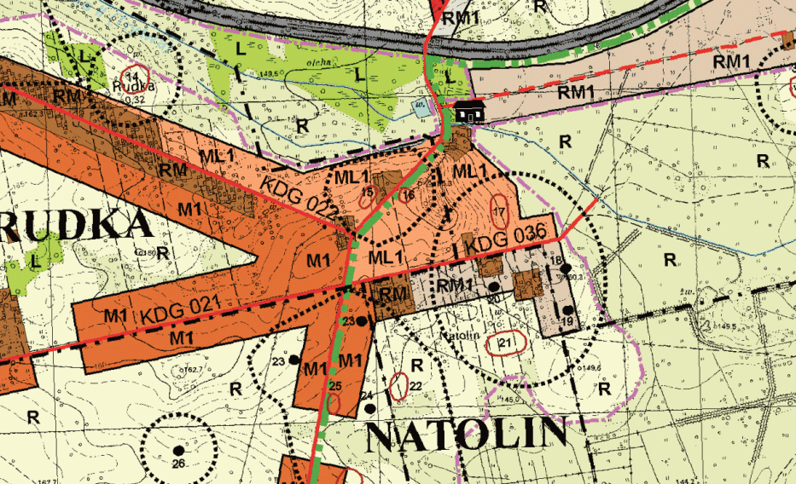
Evidence of implementation (4)
KIEG
KIUT
KIBDOT
KIMP
KISKZP

Slide 12
Evidence of implementation (5)
Till the end of 2021, there were 7.3 billion requests to KIEG service.

Slide 13

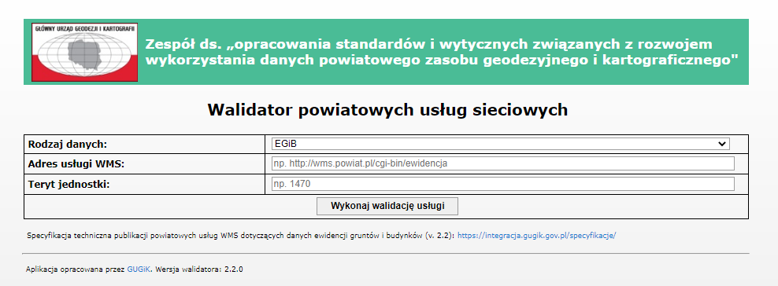
Other relevant information
Standardisation of local network services
The standards are available for
KIEG
KIUT
Validator application

Slide 14

Limitations
Additional resources are required to:
create and maintain a proxy service
develop standardisation documents
standardise local services

Slide 15
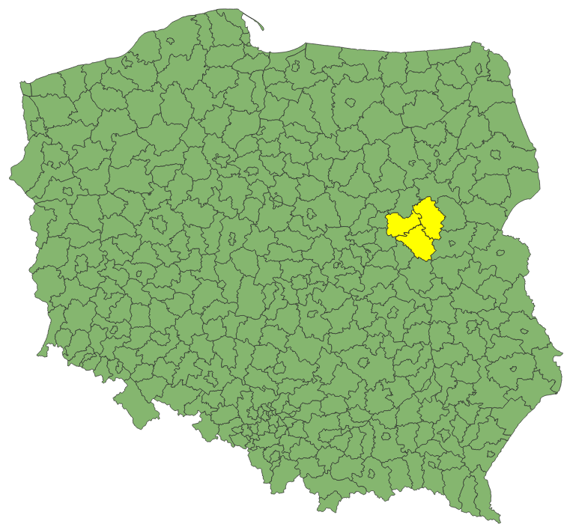
Sample implementation
Our approach
Sample service implemented integrating local WMSs from three counties
The sample service is available at http://185.238.72.102/cgi-bin/wmssampleintegration
As simple as possible
Everything documented on GitHub
Config files and documentation contains all information necessary to integrate WMS services of your choice
Based on modified MapServer

Slide 16
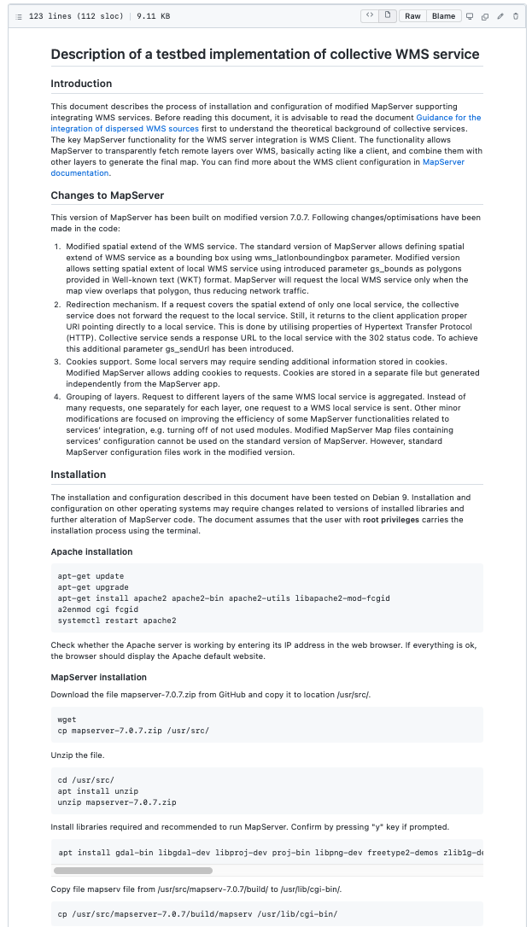
GitHub documentation
GitHub documentation contains step by step information on
installing modified MapServer
setting up collective service
sample configuration files
modified MapServer, including source codes
In addition, the documentation explains the “logic” of how a collective service operates

Slide 17

WMS server
The service is published by modified MapServer v7.0.7.
Tested on Debian 9 and Apache Server
In the case of other Linux distributions, web servers or Debian versions, some modifications of installation procedure or code may be required

Slide 18
WMS server - modifications
Following modifications/optimisations have been implemented:
Modified spatial extend of the WMS service. The standard version of MapServer allows defining the spatial extent of WMS service source as a bounding box. Modified version allows setting spatial extent of local WMS service using a dedicated parameter containing polygon geometry. MapServer will request the local WMS service only when the map view overlaps that polygon, thus reducing network traffic.
Redirection mechanism. If a request covers the spatial extend of only one local service, the collective service does not forward the request to the local service. Still, it returns to the client application proper URI pointing directly to a local service.
Cookies support. Some local servers may require sending additional information stored in cookies. Modified MapServer allows adding cookies to requests.
Grouping of layers. Request to different layers of the same WMS local service is aggregated. Instead of many requests, one separately for each layer, one request to a WMS local service is sent.

Slide 19
WMS server – additional parameters
Two parameters have been added to the standard MapServer distribution
gs_bounds – defines the spatial extent of local service
gs_sendUrl – defines whether the 302 redirections are supported

Slide 20
WMS server – requests handling
Server
A website containing information about the service
(optional)
No parameters
The static file containing modified/simplified GetCapabilities response
WMS client application
Bash script
GetCapabilities
GetFeatureInfo
Custom script integrating GFI responses of local services *
Other including
GetMap
Handled by modified Map Server
* Support of GFI not implemented in sample service

Slide 21
Summary
Integration of local services improve their usability
Transparent from a user perspective
Reproducible and customisable
Can be applied in regional, national and international use cases
More on https://github.com/INSPIRE-MIF/gp-single-access-point

Slide 22
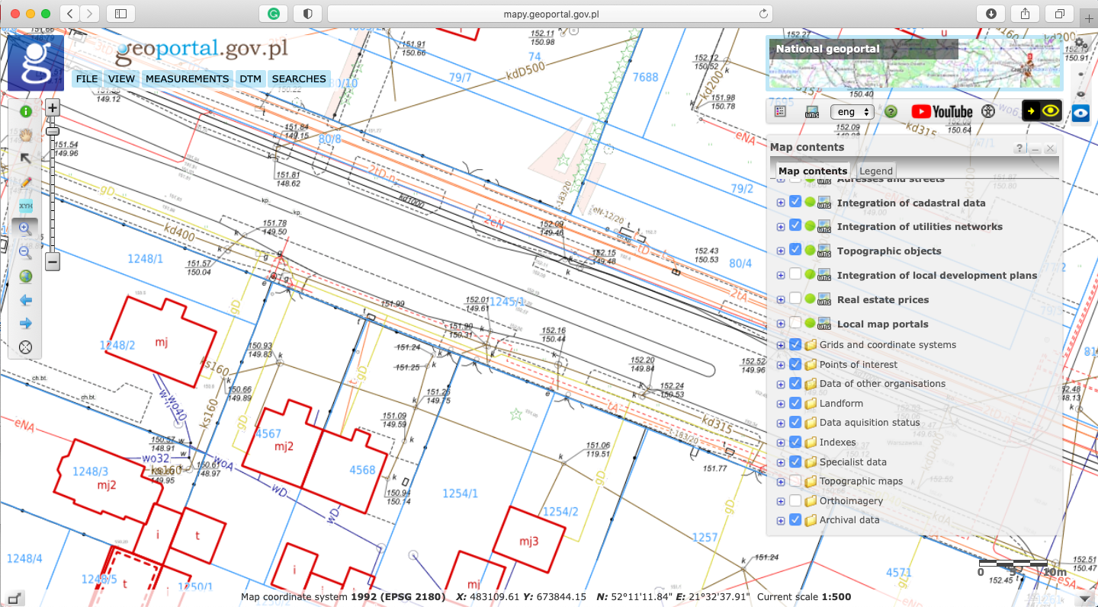
Live demo

Slide 23
Acknowledgments
JRC Team:
Jordi Escriu
Alexander Kotsev
GUGiK Team:
Waldemar Izdebski
Piotr Perz
Ewa Surma
Jarosław Zembrzuski
Aneta Seremet with team
Anna Bober
Ryszard Bojarski
And others

Slide 24
Thank you for your attention
Questions?
marcin.grudzien@gugik.gov.pl

